Slide 1


Interbull Business Meeting
21 May 2024
Meeting 2

Slide 2
Interbull Business Meeting
Matthew Shaffer
Interbull Steering Committee Chair

Slide 3

Welcome
2024 Interbull Business Meeting
Back

Slide 4




Slide 5
House Keeping
Please silence your mobile phones
Please use the microphone and state your name
Official Delegates, please sign your name on the paper

Slide 6
Business Meeting Delegates
Australia Matthew Shaffer
Austria Hermann Schwarzenbacher
Belgium Alain Gillon
Canada Brian Van Doormaal
Croatia Marija Špehar
Czech Rep. Jiri Splichal
Denmark Gert Pedersen Aamand
Estonia
Finland Gert Pedersen Aamand
France Laurent Journaux
Germany Reinhard Reents
Hungary Marija Klopčič
Ireland Ross Evans
Israel Yaniv Lavon
Italy Johannes van Kaam
Japan Takefumi Osawa
Latvia Erna Galvanovska
Lithuania Vytenis Čukauskas
Netherlands Gerben de Jong
New Zealand
Norway Janez Jenko
Poland Sebastian Mucha
Portugal Adriana Pereira
Slovakia Marija Klopčič
Slovenia Marija Klopčič
South Africa Bernice Mostert
South Korea Chang-gwon Dang
Spain Daniele Vicario
Sweden Gert Pedersen Aamand
Switzerland Urs Schnyder
United Kingdom Raphael Mrode
Uruguay Ezequiel Nicolazzi
USA Ezequiel Nicolazzi
Notes:
SIMONE to UPDATE

Slide 7
Business Meeting Agenda
Opening and welcome
Adoption of agenda
Acceptance of the minutes of the 2023 Interbull Business Meetings
ICAR Update
Interbull Strategic Plan
Interbull Governance
Interbull Centre Director’s Report - part 1
New Traits Pipeline
Business Funding Models Task Force
Interbull Centre Director’s Report - Part 2
Interbull Technical Committee / Research and Development
European Union Reference Centre
Other Matters and Open Discussion
Future Events
Close

Slide 8
Business Meeting Agenda
Opening and welcome
Adoption of agenda
Acceptance of the minutes of the 2023 Interbull Business Meetings
ICAR Update
Interbull Strategic Plan
Interbull Governance
Interbull Centre Director’s Report - part 1
New Traits Pipeline
Business Funding Models Task Force
Interbull Centre Director’s Report - Part 2
Interbull Technical Committee / Research and Development
European Union Reference Centre
Other Matters and Open Discussion
Future Events
Close

Slide 9
Interbull Business Meeting
Item 10: Interbull Centre Director’s Report – Part 2
Toine Roozen

Slide 10
Interbull Centre Services
EVALUATIONS
VALIDATION
EXCHANGE
COLLABORATION
MACE
Conventional breeding values
GenoEx-PSE
PREPdb
GMACE
GenoEx-GDE
Interbull Bulletin
InterGenomics
Genetic traits
GEBV-test
Meetings, Workshops and Webinars
Interbeef
TMACE
EURC validation
International Guidelines

Slide 11
Interbull Evaluations
Trait group | Traits
Production 1995 | Yield: Milk, protein, fat
Conformation 1999 | Body condition (19) Locomotion (6) Udder (9)
Udder health 2001 | Somatic cell score, Mastitis
Longevity 2004 | Direct longevity
Calving 2005 | Direct and maternal calving ease (2) Direct and maternal stillbirth (2)
Fertility 2007 | Heifer conception, interval, Cow recycling, lactating cow ability to conceive
Workability 2008 | Milking speed, temperament
Breeds:
Holstein
Jersey
Guernsey
Red Dairy Cattle
Brown Swiss
Simmental
Countries:
34
Country-breed-trait combinations:
1985
EVALUATIONS
MACE
GMACE
InterGenomics
Annually:
3 Official evaluations
2 Test evaluations
Notes:
This slide was presented in 2023

Slide 12

Interbeef Evaluations
Trait group | Traits
Adjusted Weaning Weight 2015 | Animal Weaning Weight
Calving Traits 2019 | Birth Weight Calving Ease - direct and maternal effects
Carcass traits 2023 | Carcass conformation Carcass fat Carcass weight
Breeds:
Aberdeen Angus
Limousin
Charolais
Hereford
Simmental
Countries:
12
Country-breed-trait combinations:
112
EVALUATIONS
  Based on phenotypes, not EBV’s.
  Different models for each country
Interbeef
Annually:
2 Official evaluations
1 Test evaluation
  Key challenges:
  International genomic evaluations
  Integration of International evaluations into National evaluations.
Notes:
This slide was presented in 2023

Slide 13
Data Exchange
NEED for Data Exchange
EXCHANGE
Accurate genetic information
Across-border collaborations
Legal requirements:
  Import-Export
  Animal Breeding Regulations
Breeding Programs
Genetic Evaluations
GenoEx-PSE
GenoEx-GDE
Genetic traits

Slide 14
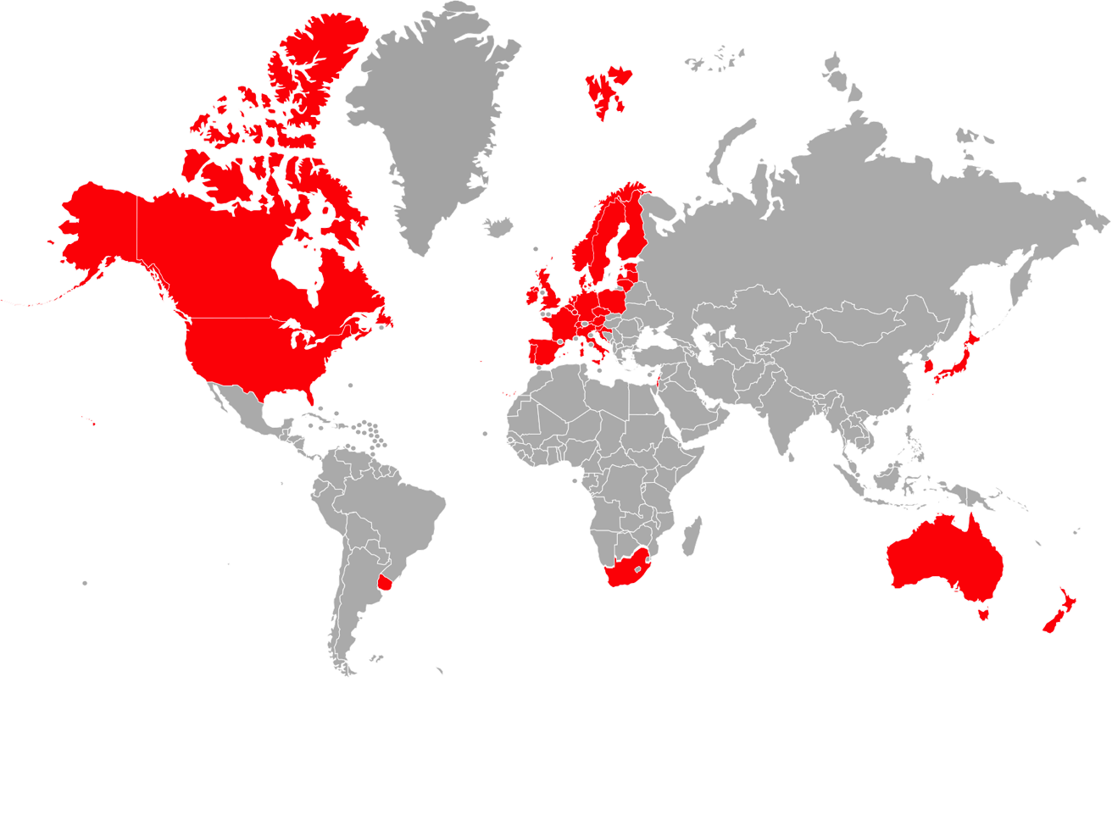
EXCHANGE
Data Exchange – Bilateral
GBR
USA
NED
Etc
HUN
AUS
NEED for Data Exchange
Accurate genetic information
Across-border collaborations
Legal requirements:
  Import-Export
  Animal Breeding Regulations
Breeding Programs
Genetic Evaluations

Slide 15
EXCHANGE
Data Exchange – Interbull DataHub
GBR
USA
NED
Etc
HUN
AUS
BENEFITS of INTERBULL DATAHUB
Facilitate and streamline activities carried out by authorised Service Users
Get information from foreign animals / Provide animal information to importing organisations
Eliminate costs of duplication
  Data Entry
  Genotyping
Greater transparency
  In interest of breed
  Often required by law

Slide 16


EXCHANGE
GenoEx-PSE
SERVICE
KEY BENEFITS
Parentage SNP Exchange (PSE) - SNP exchange only for parentage analysis
Facilitates and streamlines parentage analysis activities carried out by authorised users of the service
A defined set of SNPs can be exchanged:
  Since 2018: Parentage Verification (“PV”) – 200 SNPs (recommended by ISAG)
  NEW in 2024: Parentage Discovery (“PD”) – 354 SNPs
  ICAR DNA Data Interpretation Centre Certification required.
Access to parentage analysis genotypes for essentially all dams and AI sires and potentially missing genotypes for some sires
Bull owners have more accurate identity of progeny in countries importing semen
Eliminate costs of genotyping duplication
Webinar
April 2024

Slide 17

EXCHANGE
GenoEx-GDE
SERVICE
BENEFITS
Enables full genotype exchanges (whole SNP arrays) covering a variety of available genotyping chips
Users have full access to their own genotypes plus genotypes obtained by exchange in the system
Each user of the service has full control over which of their own genotypes it shares with other service users, and which of those service users
In use for InterGenomics – Brown Swiss and Holstein
An easy and safe exchange of genotype data (performing quality and pedigree availability checks)
Easy and standard for exchanging large genotype datasets
Facilitates building reference populations
Decreases costs by avoiding re-genotyping the same individuals
Encourages development of genomic evaluations

Slide 18
EXCHANGE
Genetic Traits Exchange
GBR
USA
NED
Etc
HUN
AUS
BENEFITS of INTERBULL DATAHUB
Facilitate and streamline activities carried out by authorised Service Users
Get information from foreign animals / Provide animal information to importing organisations
Eliminate costs of duplication
  Data Entry
  Genotyping
Greater transparency
  In interest of breed
  Often required by law

Slide 19
EXCHANGE
Genetic Traits Exchange
BENEFITS of INTERBULL DATAHUB
Facilitate and streamline activities carried out by authorised Service Users
Get information from foreign animals / Provide animal information to importing organisations
Eliminate costs of duplication
  Data Entry
  Genotyping
Greater transparency
  In interest of breed
  Often required by law
European Union Regulation 2016-2012:
Make publicly available the information on the genetic defects and genetic peculiarities of breeding animals which are related to the breeding programme.
Notes:
Part 3. (Requirements for genetic evaluation)
10. The breed society or the breeding operation, or, at the request of that breed society or breeding operation, the third party designated by that breed society or breeding operation in accordance with Article 27(1)(b), shall:
make publicly available the information on the genetic defects and genetic peculiarities of breeding animals which are related to the breeding programme.

Slide 20
EXCHANGE
Genetic Traits Exchange
BENEFITS of INTERBULL DATAHUB
Request from WHFF (2016):
Service for exchanging gene test results
  Mainly undesirable genetic recessive traits
  Also favourable characteristics
  Holstein, 2019
    Germany, Great Britain, Netherlands
  Brown Swiss, 2023
    Switzerland, Italy, USA, Germany, Austria
Facilitate and streamline activities carried out by authorised Service Users
Get information from foreign animals / Provide animal information to importing organisations
Eliminate costs of duplication
  Data Entry
  Genotyping
Greater transparency
  In interest of breed
  Often required by law
European Union Regulation 2016-2012:
Make publicly available the information on the genetic defects and genetic peculiarities of breeding animals which are related to the breeding programme.
Notes:
Part 3. (Requirements for genetic evaluation)
10. The breed society or the breeding operation, or, at the request of that breed society or breeding operation, the third party designated by that breed society or breeding operation in accordance with Article 27(1)(b), shall:
make publicly available the information on the genetic defects and genetic peculiarities of breeding animals which are related to the breeding programme.

Slide 21
EXCHANGE
Genetic Traits Exchange - Value
2019
Input = 230,000 records
100,000 unique animals
  95,000 ⚣, 5,000 ⚢
Output = 265,000 records with genetic trait information
Extra records:
  vit, Germany: +13%
  AHDB/SRUC, Great Britain: + 26%
  CRV, Netherlands: +8%

Slide 22
EXCHANGE
Genetic Traits Exchange - Value
2019
Input = 230 000 records
100,000 unique animals
  95,000 ⚣, 5,000 ⚢
Output = 265,000 records with genetic trait information
Extra records:
  vit, Germany: +13%
  AHDB/SRUC, Great Britain: + 26%
  CRV, Netherlands: +8%
2024
Input = 633 759 Holstein records
Traits approved by WHFF Council
BLAD
Mule foot
DUMPS
CVM
Factor X1
CIT
Brachyspina
Polled (Current – Indirect Test)
Cholesterol Deficiency
Red
Black / red
Black

Slide 23
EXCHANGE
Genetic Traits Exchange – HOL
2024
Meetings with WHFF:
Interest in participation from:
  Holstein Canada
  Prim’Holstein (France)
Highlighting importance of protocols to timely introduce newly discovered genetic traits:
  BLIRD
    Bovine Lymphocyte Intestinal Retention Defect
  Muscle Weakness
    Early Onset Muscle Weakness Syndrome
2024
Input = 633 759 Holstein records
Traits approved by WHFF Council
BLAD
Mule foot
DUMPS
CVM
Factor X1
CIT
Brachyspina
Polled (Current – Indirect Test)
Cholesterol Deficiency
Red
Black / red
Black

Slide 24
EXCHANGE
Genetic Traits Exchange – BSW
Brown Swiss
ASR, Switzerland
ANARB, Italy
Brown Swiss Cattle Breeders Association, USA
BRS, Germany
2024
Input = 159 141 Brown Swiss records
Arachnomelia
Beta-Casein
Kappa-Casein
Polledness
Renal Dysplasia
Spinal Dysmyelination (SDM)
Spinal Muscular Atrophy (SMA)
Bovine Progressive Degenerative Myeloencephalopathy (Weaver)

Slide 25
EXCHANGE
Genetic Traits Exchange
SERVICE
BENEFITS
Collection, exchange and conflict resolution of information on genetic traits
Sharing of updated information regarding genetic traits
Automated data exchange via the Interbull Data Exchange Area (“IDEA”)
Distributed 3 times per year with official evaluations
Identify animals which are carriers of important genetic traits
Allows an easier, safer and more efficient exchange of information on genetic traits
Consistency of unique international animal ID is maintained across countries
Reduction in conflicting information
Responsive to newly recognised traits

Slide 26
Interbull Business Meeting
Item 10: Interbull Centre Director’s Report – Part 2
Toine Roozen

Slide 27
Interbull Business Meeting
Item 11. Interbull Technical Committee / Research and Development
Gerben de Jong

Slide 28
Latest Recommendations Approved (1/3)
The SC has recently approved of the following ITC recommendations:
Fertility Harmonization https://interbull.org/ib/servicedocumentation
  Use of “highly recommended” traits for the different Interbull traits
    Increase countries’ correlations
  If not available, considering using only of “accepted traits”
 | Conception Rate (CR) | Pregnancy Rate (PR)# | Interval first-last insemination (FL) | Interval first insemination –conception (FC) | Number of inseminations (NI) | Non-return rate (NR) | Interval calving-first insemination (CF) | Days open (DO) | Calving interval (CI)
HCO | ** |  | * | * | * | *
CRC |  |  |  |  |  |  | ** | * | *
CC1 | ** |  |  |  |  | **
CC2 |  | * | ** | ** | * |  |  | * | *
INT |  | ** |  |  |  |  |  | ** | **
** - highly recommended trait; * - accepted trait;
  #Pregnancy Rate to be used ONLY if the trait is clearly calculated as a function of Days Open (DO).

Slide 29
Latest Recommendations Approved (2/3)
New GEBV-test Software
  Input files required:
  Official Interbull test based on VanRaden’s de-regressed GEBV (2021 Interbull bulletin).
  Default base-adjustment for full/truncate EBV files
  De-regressed GEBV derived from 300Gf and 300Gr evaluations in the same way for all countries by the new software
    De-regression method gets internationally standardized
  A Bootstrapping approach has been implemented instead of a t-test for testing the bias in validation slopes
  Program will be made available to users -> To be officially introduced in August 2024
Full Data | Truncated Data
Conventional + Genomic (new file) | Conventional + Genomic

Slide 30
Latest Recommendations Approved (3/3)
Genomic Reliabilities Guidelines https://interbull.org/ib/servicedocumentation
The Genomic Reliability WG has worked on a set of guidelines regarding the estimation of the genomic reliability, in general, and the application of the Interbull method, in particular:
  Guidelines for Approximating Genomic Reliabilities of the Single-Step Genomic Model
  Guidelines for Deriving Genomic Effective Daughter Contribution Gain

Slide 31
Genomic Reliability Status Update
Work on guidelines for evaluations with small reference populations
  New traits
  Small breeds
Breed-specific genomic reliability adjustment in a multi-breed evaluation system.

Slide 32
Validation WG Status Update
Revise interbull Test III so it can be used on young generation’s bulls
  Test Mendelian Sampling Variance test to account for the mean of the MS term to deviate from zero (under final testing)
  Applicable for situation with genomic selection
Review biological limit applied in GEBVtest
  Based on countries’ experience on new GEBVtest software

Slide 33
Review of MACE Coding Status Update
New working group, chaired by Raphael Mrode
  Review current Type of Proofs coding
  Assess needs for new coding in the genomic era
  Provide guidelines on application of the coding

Slide 34
Review of Current Service Schedule
New working group, chaired by Jan-Thijs van Kaam:
  Provide a plan to create some more time between the MACE pre-release and the start of GMACE, without increasing the overall time of the evaluation
    Latest MACE proofs could be used as input to GMACE
  Provide a plan to reduce the overall evaluation time
    Previous MACE proofs would be used as input to GMACE
  Review the schedule and frequency of Truncated MACE (TMACE)
  Explore possibility to allocate for an extra test run in May

Slide 35



International evaluations in genomics era
(Future MACE working group)
Pete Sullivan (Lactanet, Canada)
Gerben deJong (CRV u.a., Netherlands)
Ismo Strandén (Luke, Finland)
Valentina Palucci (Interbull, Sweden)

Slide 36
Benefits of a new MACE system
Unbiased genetic trend in MACE proofs that are used for selection in some countries
Unbiased MACE proofs become directly comparable to national EBV and national GEBV of local bulls
Unbiased MACE proofs for input to national GEBV
Unbiased PA from MACE as input to GMACE

Slide 37
Key Reports and Activities
JDS: National EBV are biased w/o genotypes used for GPS (Patry and Ducrocq, 2011)
JDS: MACE proofs include the national EBV bias (Patry et al, 2013)
Interbull workshop: Adapting MACE for GPS (Slovenia, 2017 Feb)
Interbull Technical Committee and Working Groups: tasked to quantify GPS effects and simulate GPS data to test future MACE approaches (Estonia, 2017 Aug)
Interbull meeting: Modifying MACE for GPS (USA, 2019 Jun)
Interbull webinar: Genomic-free input for MACE (2021 Feb)
Interbull meeting: Genetic regressions for GPS in MACE (Canada, 2022 May)
Interbull workshop: Implementing GPS-MACE (Italy, 2023 Feb)
Literature Review: IB 55
https://Interbull.org
Model Application: IB 58

Slide 38
Status of Future MACE
August 2023 (Lyon meeting)
Accounting for estimates of GPS effects on MS means:
  Encouraging results from sensitivity studies with alternative shrinkage parameters
  Parameters should be estimated for optimal MS mean adjustments
Accounting for GPS effects on MS variances:
  Methods are available but testing is in early stages
Using GPS-MACE results within the GMACE evaluation:
  Impacts on GMACE results should be checked with the final GPS-MACE model
  Biggest improvements for national GEBV conversions to non-genomic countries

Slide 39
Status of Future MACE
May 2024 (Bled meeting)
Accounting for estimates of GPS effects on MS means:
  Encouraging results from sensitivity studies with alternative shrinkage parameters
  Parameters should be estimated for optimal MS mean adjustments
Accounting for GPS effects on MS variances:
  Methods are available but testing is in early stages (MS versus ANIMAL model?)
Using GPS-MACE results within the GMACE evaluation:
  Impacts on GMACE results should be checked with the final GPS-MACE model
  Biggest improvements for national GEBV conversions to non-genomic countries
Implement GPS-MACE programs for a pilot run by ITBC

Slide 40
Improving GPS-MACE input data
May 2024 (Bled meeting)
GPS-MACE works now, but it will be even better with new national EBV
  National EBV without genotypes do not include GPS effects
    True GPS effects are underestimated (but not zero) from the current national EBV
    The underestimates are better than assuming no GPS effects at all
Better inclusion of GPS effects in national EBV will increase the magnitudes of GPS effects estimated in GPS-MACE, but how do we do it?
    Can a GPS-EBV model that is like GPS-MACE be used at the national level?
    Can ssGEBV be partitioned to remove individual genotype effects but keep GPS?
    Can a de-regressed ssGEBV be used instead of a de-regressed EBV?
    A presented option from France at the 2024 meeting in Bled ***

Slide 41
Interbull Business Meeting
Item 11. Interbull Technical Committee / Research and Development
Gerben de Jong

Slide 42
Interbull Business Meeting
Item 11. Interbull Technical Committee / Research and Development
Valentina Palucci

Slide 43
Interbull Centre - Guiding Principles
  Customer-Oriented – we align our objectives around understanding and satisfying our customers’ requirements.
  Accurate – we are committed to measurements and data being correct and precise.
  Unbiased – we work with an open mind and no bias.
  Independent – we make decisions and act in the best interests of the global Interbull network, not any individual organization.
  Integrity – we act with honesty and consistency in whatever we do.
  Transparency – we are committed to open, two–way communication.
  Cost-Effective – we strive to find the most cost-effective means for customers to achieve their goals.
  Innovative and Leading-Edge Services – we continually look for new and better ways of doing things.

Slide 44
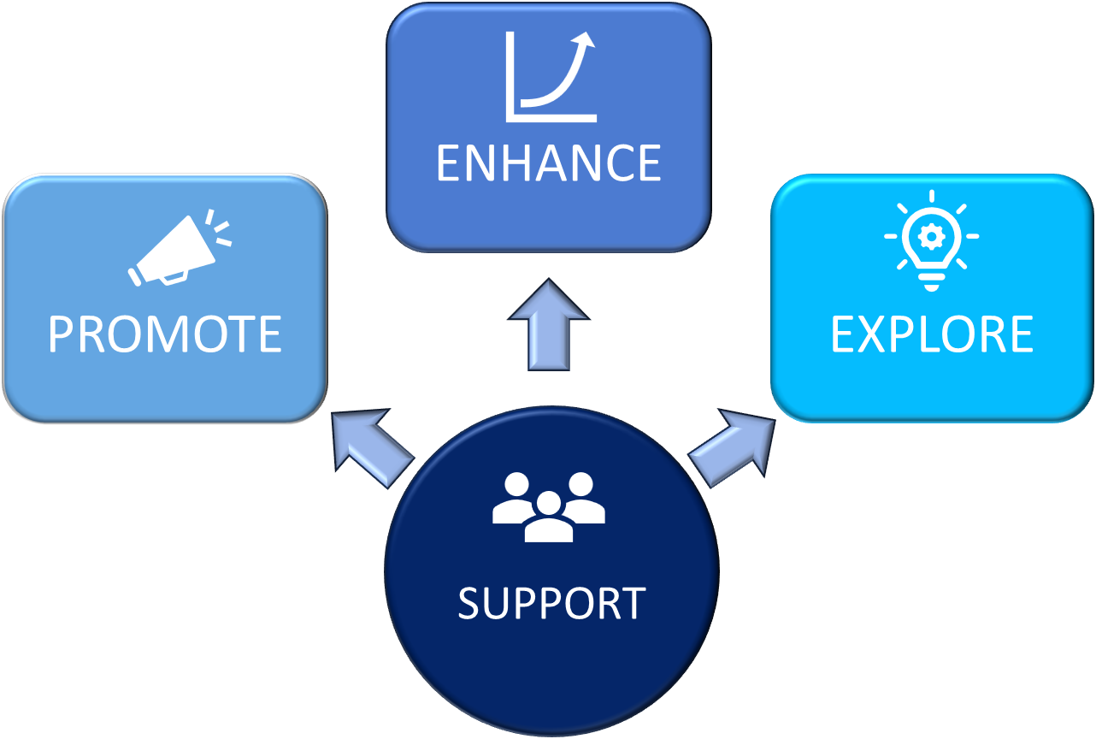
New Strategic Plan
Four new pillars identified
existing services to increase value and relevance to current and new service users.
expansion of existing services to current and new service users
different service options to underpin Interbull’s future
capability and collaboration to effectively deliver Interbull’s success

Slide 45


2024 Annual Operating Plan
Interbull Webinar’s Series
  GenoEx-PSE, GenoEx-GDE
New webpage
Increase awareness and participation to existing services

Slide 46
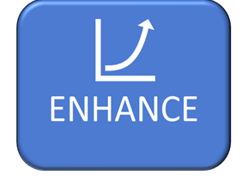
2024 Annual Operating Plan
New Traits
Continue refinement of methodologies for dairy validation
  New GEBVtest
  MS test
Develop of beef validation’s methodologies
  Developed an adjusted dairy method II for beef data
  Continue developing new specific methods
Improve beef VCE procedures
  Standardize methodology and software -> aim to take it in-house
  Provide clearer guidelines on when VCE is required

Slide 47

2024 Annual Operating Plan
GenoEx-GDE: Improve the user query extraction interface
  Mark of mandatory fields, avoiding extraction to abort silently due to missing information
  Extract animals with an updated sharing permission record
GenoEx-GDE: for other species than cattle (multispecies)
  Current development’s plans for Horse and Sheep
PREP
  Inclusion of electronic forms for udder health, longevity, workability
  Expansion to collect descriptive information for national genomic evaluations

Slide 48
Interbull Business Meeting
Item 11. Interbull Technical Committee / Research and Development
Valentina Palucci

Slide 49
Interbull Business Meeting
Item 12. European Union Reference Centre
Toine Roozen

Slide 50

EU Animal Breeding Regulation
EU Legislation 2016/2012
Legal framework for the rules applicable to the breeding, trade and entry into the European Union of breeding animals and their germinal products; cattle, pigs, sheep, goat and horses.
Applicable since 1 November 2018:
  rules for the promotion of free trade in breeding animals and their germinal products
  promote cross-border activities of breed societies
  rules on official controls and activities
Legal basis for official recognition of breeding organisations and for approval of their breeding programs
Implementing Regulations:
European Union reference centre – Zootechnics (1 November 2018)
European Union reference centre – Endangered Animal Breeds (1 January 2023)

Slide 51
European Union Reference Centre (EURC) for Zootechnics (Bovine Breeding)
Promotion of harmonisation or improvement of the methods of performance testing or genetic evaluation.
-Develop and improve standardised methods
-Create transparancy and assist with harmonisation
-Facilitate implementation
  Genomic Reliability (Presentations by Zengting Liu/Gerben de Jong)
  Interbull DataHub
  Validation methodologies
  PREP Database and ICAR-Interbull Guidelines
Notes:
The Animal Breeding Regulation provides a single legal framework for the rules applicable to the breeding, trade and entry into the Union of breeding animals of the bovine, porcine, ovine, caprine and equine species and their germinal products.
The following delegated and implementing acts were adopted by the Commission to make the new rules applicable >
Zootechnical certificate for purebred breeding animals of the bovine, porcine, ovine and caprine species and for hybrid breeding pigs
Zootechnical certificate for purebred breeding animals of the equine species
Model forms for listing of recognised breed societies and breeding operations
European Union reference centre for bovine animals
European Union reference centre for endangered animal breeds

Slide 52
EU Animal Breeding Regulation
Breeding Organisations must “make publicly available the information on the genetic defects and genetic peculiarities of breeding animals which are related to the breeding programme”.
Interbull Centre does NOT publish such data, but facilitates easier transfer through the Interbull DataHub:
“Genetic Traits Exchange”

Slide 53
EU Animal Breeding Regulation
Genetic Evaluation and Validation
AI Bulls must have a (g)EBV:
Genetic evaluation methodologies
Calculation of reliabilities
Genomically evaluated bulls:
Genomic evaluation method validated for each genomically evaluated trait;
All traits to be revalidated
GEBVtest is valid for (max) two years
………in accordance with EURC rules and standards.
Minimum reliabilities:
50% (Dairy Bulls)
30% (Beef Bulls)

Slide 54

Validation
One of Interbull Centre’s /EURC’s most important roles
Develop, maintain and improve Validation Methodologies
Testing national evaluation results for consistency
Public recognition:
  Independent assessment and quality assurance of (G)EBVs
  Assurance that statistical models applied are sound and appropriate to the data → Reducing bias in data, increase quality.

Slide 55
Validation methods of national (G)EBVs
Conventional Validation
4 Validation tests available:
  Trend Validation Tests (Methods I, II, III)
  Mendelian Sampling Variance Test;
  Prerequisite for marketing/using progeny tested bulls in EU
Genomic Validation
1 test available: “GEBV-test”
Prerequisite for marketing/using genomically tested bulls in EU
EURC Validation
Independent validation of genetic evaluation models
Available to all breeds and all European breeding organisations and NGECs
Population size may limit relevance of tests
Beef Validation
Under development
Challenging due to industry structure:
  → Low AI, Small contemporary groups, fewer well proven bulls
Notes:
Taken from Reinhard (BM 2023) --- Toine to adapt
Refer to EU Regulations

Slide 56
Validation results – dairy
International evaluations
Total Number of Validations of national results, including:
  Trend Validation Tests (Methods I, II, III);
  Mendelian Sampling Variance Test;
  GEBVtest
Notes:
Not included:
Greece
Malta
Cyprus
Rumania
Bulgaria

Slide 57
See Open Meeting – Anahit Nazari
PREPdb
Performance Recording, Evaluation and Publication Database (PREPdb)
A platform for breed societies and National Genetic Evaluation Centres to submit and share descriptive information regarding performance recording, national genetic evaluation systems and publication policies in a standardised way.
Publicly accessible
Transparent: collecting and sharing of information on a wide range of breeds and traits.
Harmonisation & standardisation
ICAR-Interbull Guidelines:
  Calving-2022, Fertility-2024
Identifying Opportunities and Challenges for EURC and Interbull
Notes:
Descriptive information regarding performance recording, national genetic evaluation systems and publication policies

Slide 58
Interbull Business Meeting
Item 12. European Union Reference Centre
Toine Roozen

Slide 59
Interbull Business Meeting
Item 13: Other Matters and Open Discussion
Matthew Shaffer

Slide 60
Proposed timeline for introducing new trait groups
Set up one working group per trait group – including participating organisations.
Issue a data call for Claw Health traits in October 2024
Preliminary review of trait definitions (Claw Health) by early December 2024
Issue a data call for Metabolic traits in January 2025
Preliminary correlations estimations for claw health traits by June 2025 (Annual meeting)
Preliminary review of traits definitions (Metabolic Traits) by June 2025 (Annual meeting)

Slide 61
Other updates
Patents
Cyber-attacks

Slide 62
Interbull Business Meeting
Item 14: Future Events
Matthew Shaffer
Notes:
Future Events
We already mentioned the upcoming webinars….

Slide 63
Interbull Annual Meetings
ICAR:
2024 – Bled, Slovenia
2022 – Montreal, Canada
2021 – Leeuwarden, Netherlands
2020 – Leeuwarden, Netherlands
2018 – Auckland, New Zealand
2016 – Puerto Varas, Chile
EAAP:
2023 – Lyon, France
2021 – Davos, Switzerland
2017 – Tallin, Estonia
ADSA:
2019 – Cincinnati, USA
2015 – Orlando, USA
Notes:
Matthew?
International collaboration - Rotation
(Why rotation?)
Insert Map?
ICAR
EAAP
ADSA

Slide 64

Interbull Annual Meetings
ICAR:
2024 – Bled, Slovenia
2022 – Montreal, Canada
2021 – Leeuwarden, Netherlands
2020 – Leeuwarden, Netherlands
2018 – Auckland, New Zealand
2016 – Puerto Varas, Chile
EAAP:
2023 – Lyon, France
2021 – Davos, Switzerland
2017 – Tallin, Estonia
ADSA:
2019 – Cincinnati, USA
2015 – Orlando, USA
Louisville, Kentucky, USA
21-23 June 2025: Interbull Annual Meeting
22-25 June 2025: ADSA Annual Meeting
Notes:
Matthew?
Louisville is 100 miles from Cincinnati…
International collaboration - Rotation
(Why rotation?)
ICAR
EAAP
ADSA

Slide 65

Interbull Business Meeting

Slide 66
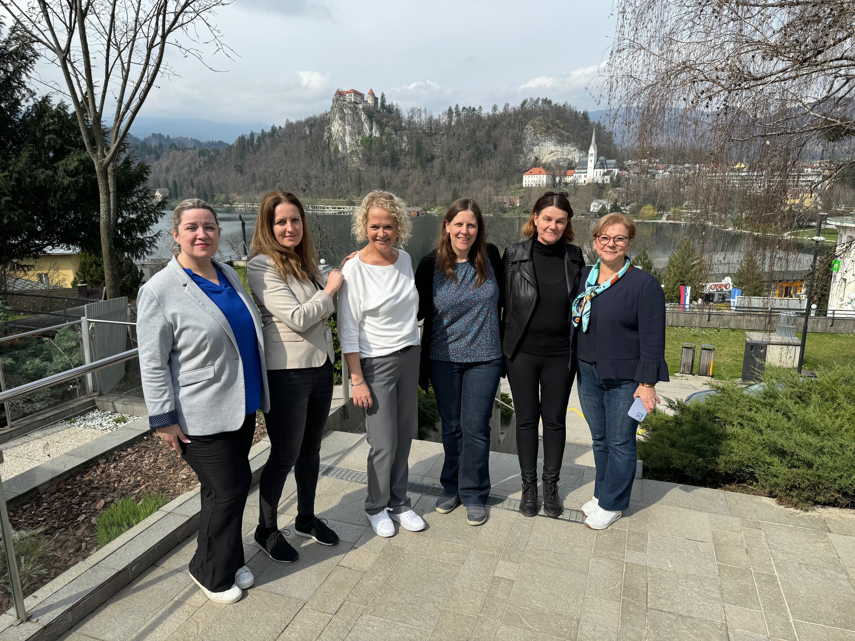
Thank you!
Yvonne De Gier, Špela Pipan, Nina Bernard, Simone Hazas, Marija Klopcic, Marie Mourot

Slide 67
Interbull Business Meeting
Item 15: Close
Matthew Shaffer

Slide 68

Špela Pipan, Nina Bernard, Marija Klopcic,, Yvonne De Gier, , Simone Hazas, Marie Mourot

Slide 69


